Slide 1
PROJECT #1
Database Concepts
Spring 2021
Week 6

Slide 2
Requirement for Project #1
50 pts.
ERD (connectivities, PKs, FKs, relationship participation); Each table must include five records (30pts)
Be able to forward-engineer (20pts)
25 pts.
Data dictionary as Excel spreadsheet file
25 pts.
SQL queries and query result sets
Notes:
Forward-engineering: the process of building from a high-level model or concept to build in complexities and lower-level details.
Forward engineering in SQL is using a script or database model to create or alter a new database: https://dev.mysql.com/doc/workbench/en/wb-forward-engineering.html
Reverse engineering in SQL is creating a script or model based on an existing database: https://dev.mysql.com/doc/workbench/en/wb-reverse-engineering.html

Slide 3
Submission
Upload three files (a mwb.file, an Excel spreadsheet, and a Word document for SQL statements and query result sets) via submission link in Canvas by Feb. 21(11:59 pm)

Slide 4
Business rules
The local city youth league needs a database system to help track children that sign up to play soccer. Data needs to be kept on each team and the children that will be playing on each team and their parents. Also, data needs to be kept on the coaches for each team.
Entities required: Team, Player, Coach, and Parent.
Attributes required:
Team: Team ID number, Team name, and Team colors.
Player: Player ID number, Player first name, Player last name, and Player age.
Coach: Coach ID number, Coach first name, Coach last name, and Coach home phone number.
Parent: Parent ID number, Parent last name, Parent first name, Home phone number, and Home Address (Street, City, State, and ZIP Code).

Slide 5
Business rules
Relationship:
Team is related to Player.
Team is related to Coach.
Player is related to Parent.
Connectivity:
A Team may or may not have a Player.
A Team may have many Players.
A Player must have a Team.
A Player has only one Team.
A Team may or may not have a Coach.
A Team may have many Coaches.
A Coach must have a Team.
A Coach has only one Team.
A Player must have a Parent.
A Player may have many Parents.
A Parent must have a Player.
A Parent may have many Players.

Slide 6
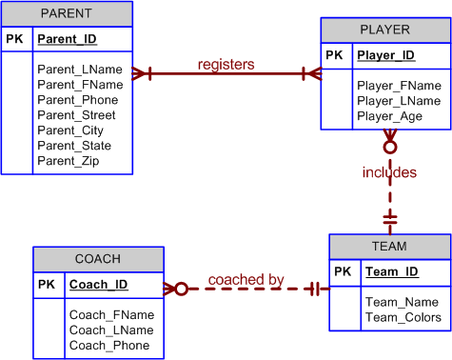
Conceptual ERD for Project 1

Slide 7
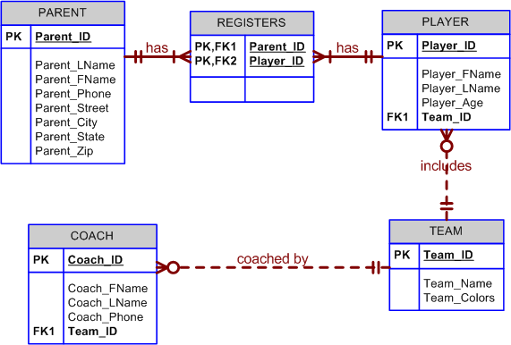
ERD with foreign keys for Project 1

Slide 8
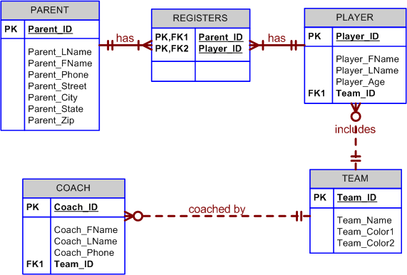
ERD with two team colors for Project 1

Slide 9
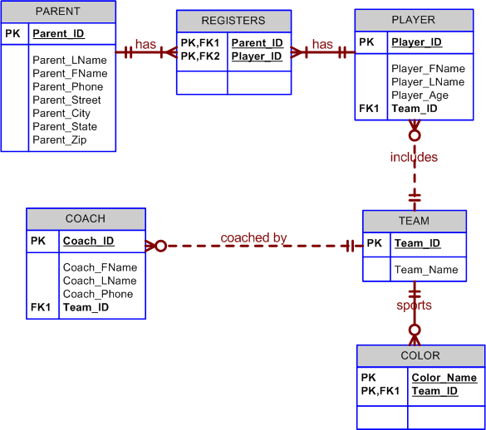
ERD with Color table for Project 1

Slide 10
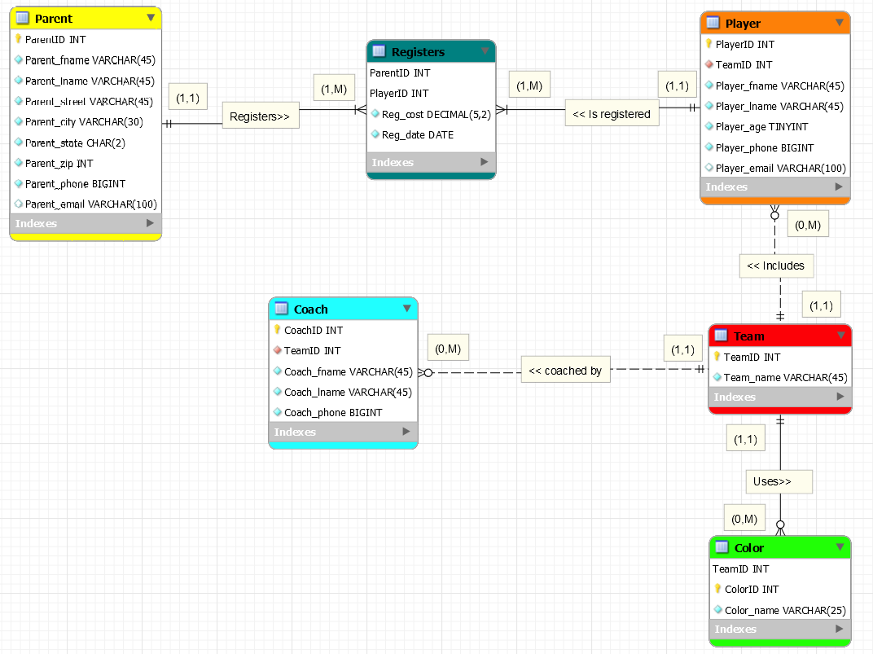

Slide 11
Data Record
Save your
data changes

Slide 12
Data dictionary
Data dictionary: Description of all tables in the database
created by the user and designer
“the database designer’s database” : it records the design decisions about tables and their structures.
Reference Chapter 3, page #89

Slide 13
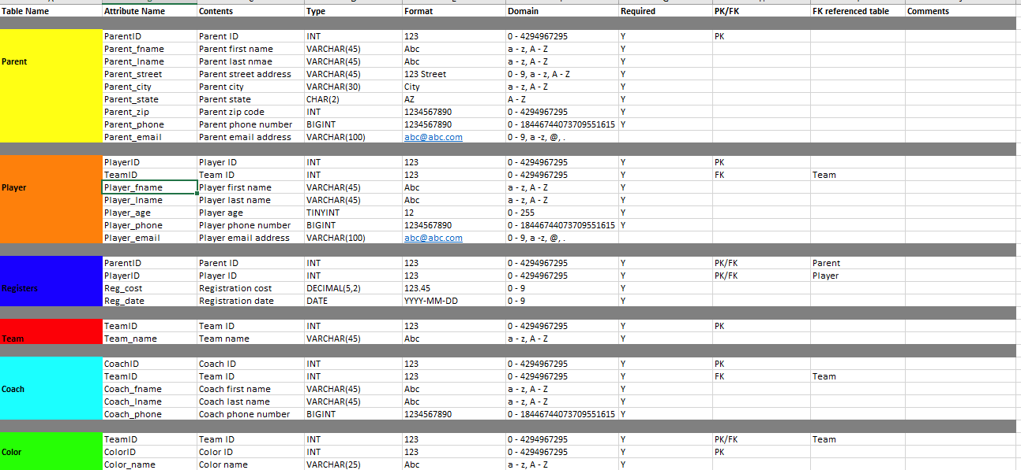
Data dictionary

Slide 14
Data type ranges
Reference
- http://dev.mysql.com/doc/refman/5.0/en/integer-types.html

Slide 15
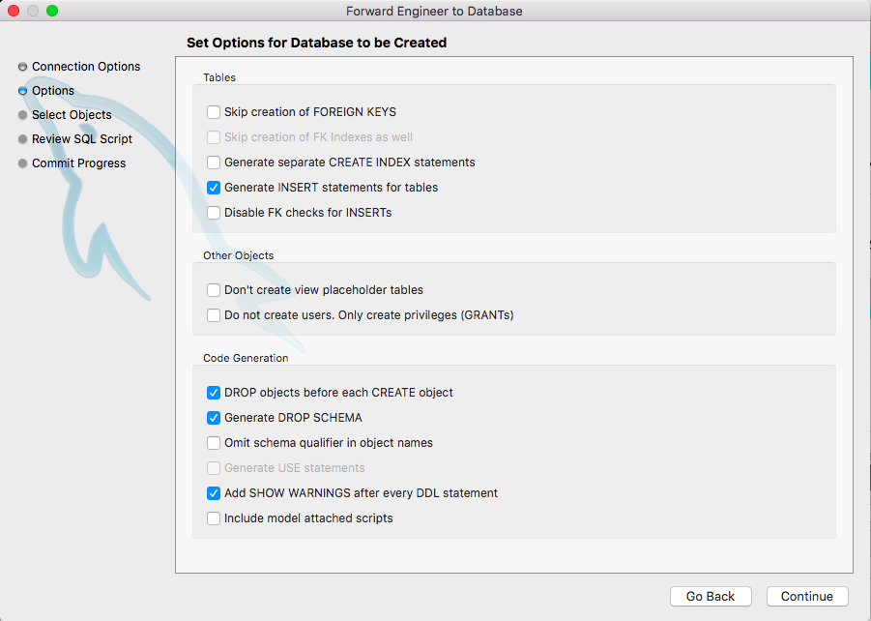
Forward engineering
Choose the Database, Forward Engineer... menu
Click Next after setting the connection parameters
Set Options for Database to be Created as below

Slide 16
Forward engineering (cont’d)
4. SQL Object Export Filter page where you select the objects you wish to export
5. After selecting the objects to export, click Continue to review the generated script.

Slide 17
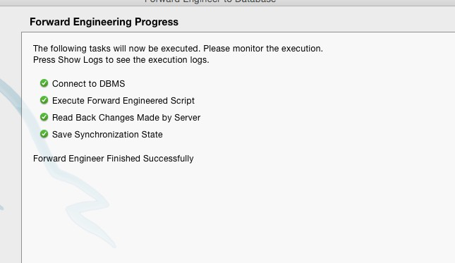
Forward engineering (cont’d)
The Finish button saves the script file and exits. You can then use the saved script to create a database.
Check if you forward engineered successfully.

Slide 18
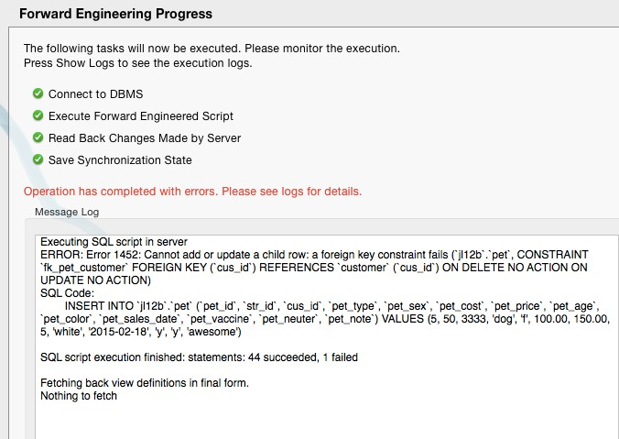
Forward engineering errors !?!

Slide 19
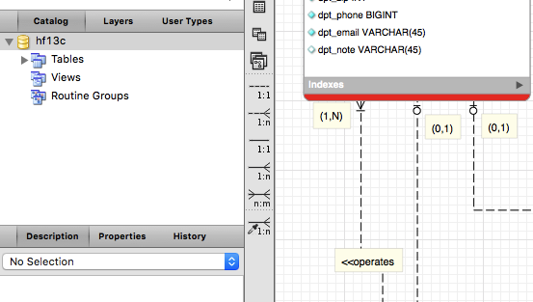
Common error #1

Slide 20
Common error #2
*Entity integrity: Every table must have a PK, and the PK cannot be null

Slide 21
Common error #3
*Referential Integrity
A FK must have matching values in the PK of another table.
A FK setting (e.g., data type) must be consistent with the PK setting.

Slide 22
Common error #3
*Referential Integrity
A FK must have matching values in the PK of another table.
A FK setting (e.g., data type) must be consistent with the PK setting.

Slide 23
SQL statement questions
List all parents’ first and last names, and full addresses;
List all players' first and last names, as well as their parent ID using only one SQL statement;
Update coach ID #2’s first and last names to “John Doe.” Display coach ID #2’s first and last names to verify that it has been updated;
Add two new teams, using only one SQL statement (include attributes). Then, display only the team IDs and names to verify that two records have been added;
Remove the first 3 colors; after which, display the remaining color names to verify that they have been removed.

Slide 24
Copy and Paste Query Results

Slide 25
SQL statement #1
List all parents’ first and last names, and full addresses;
SELECT attribute 1, attribute 2, attribute 3, attribute 4, attribute 5, attribute 6
FROM parent;

Slide 26
SQL statement #2
List all players' first and last names, as well as their parent ID using only one SQL statement;
SELECT attribute 1, attribute 2, attribute 3
FROM player
NATURAL JOIN registers;

Slide 27
SQL statement #3
Update coach ID #2’s first and last names to “John Doe.” Display coach ID #2’s first and last names to verify that it has been updated;
UPDATE coach
SET attribute 1 = ‘John’, attribute 2= ‘Doe’
WHERE coach ID= 2;
SELECT attribute, attribute 2 FROM coach;

Slide 28
SQL statement #4
Add two new teams, using only one SQL statement (include attributes). Then, display only the team IDs and names to verify that two records have been added:
INSERT INTO team
(attribute 1, attribute 2)
VALUES
(‘ value 1’, ‘value 2’),
(‘value 1’, ‘value 2’);
SELECT attribute 1, attribute 2 FROM team;

Slide 29
SQL statement #5
Remove the first 3 colors; after which, display the remaining color names to verify that they have been removed.
DELETE FROM color
WHERE color ID = 1 or color ID =2 or color ID =3;
SELECT color ID from color;

